Slide 1
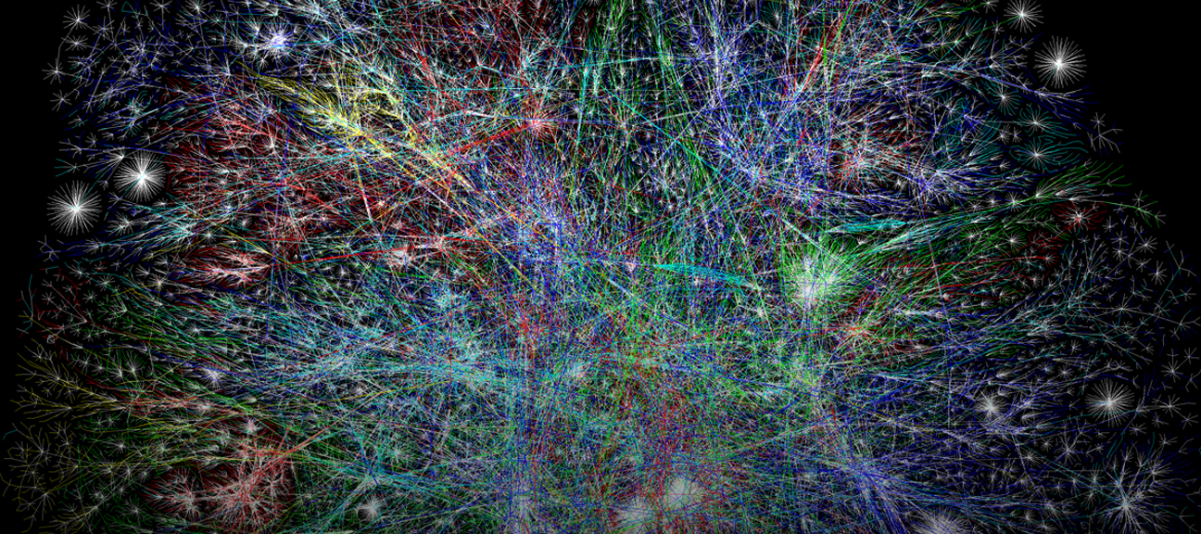
Predicting and Classifying Cognitive and Psychological Traits Using Computational Multiplex Networks
Gal Samuel
Technion – Israel Institute of Technology
Notes:
Hi everyone, My name is Gal, I’m very excited to be here. ☺

Slide 2

Complex Behavior
Openness to Experience
High Level Cognition
Creativity
Notes:
Openness to Experience is sometimes described as “the enjoyment of novel experiences and ideas”
Of the big 5 personality traits most strongly related to high-level cognitive functions, such as creativity. Yet, the role of cognitive capacities in Openness to Experience is still far from being fully understood.
What we do know related to semantic memory structure
So is creativity.

Slide 3
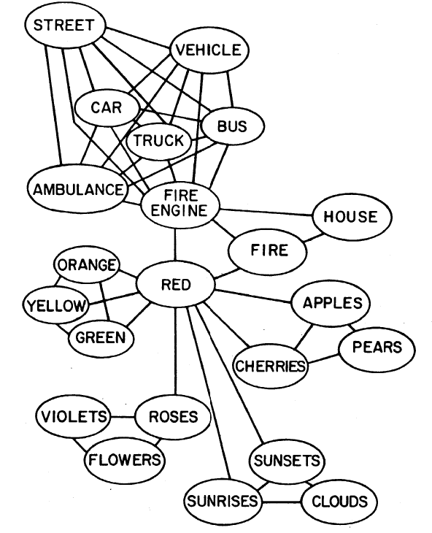
Network science
Model Information
Nodes and Edges
Semantic Networks
Collins and Loftus (1975)
Notes:
In order to research them
Field in math, used to model information, data
It uses nodes (junctions) and edges to do that
In this field, every node represents one datum, and related pieces of information are linked.
Each network has a rule
But concepts are organised

Slide 4
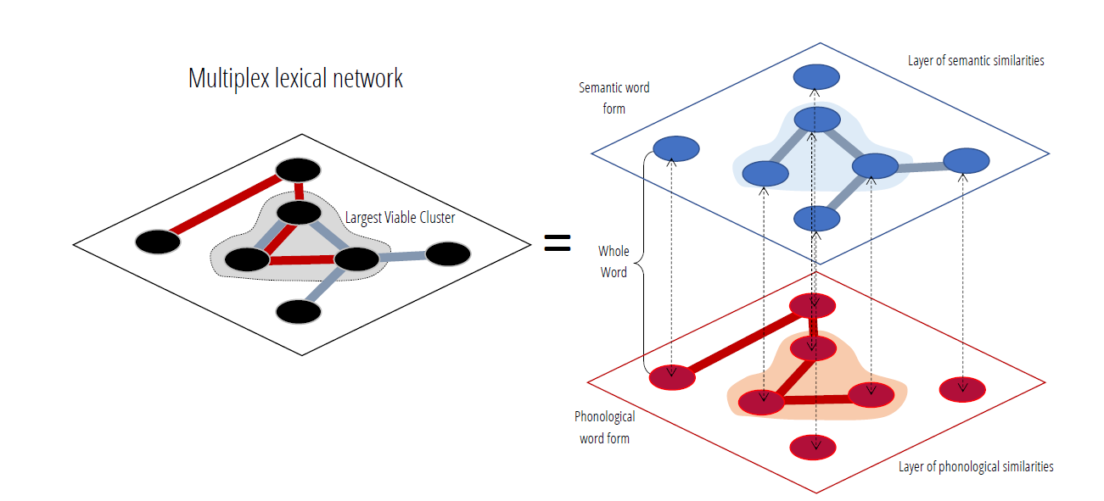

Multiplex networks
Multiplex Networks
Mental Lexicon
Largest Viable Cluster (LVC)
Semantic Fluency Task
Stella, M., & Kenett, Y. N. (2019). Viability in multiplex lexical networks and machine learning characterizes human creativity. Big Data and Cognitive Computing, 3(3), 45.
Notes:
This is why we’re using multiplex networks
They are created from a few individual layers which are compressed into one layer – in our case all of these layers are linguistic
Layers have overlapping nodes
All links are preserved (if two nodes are connected in even one layer, they would be connected in the multiplex)
Built from 15,000 words
Phonological layer, Associative layer, Synonyms layer and Hypernyms layer.
This structure is important to us, because it allows us to model the “Mental lexicon”. Our cognitive structure of language if you may.
Inside the multiplex network there is an important component, the largest viable cluster, or in short, the LVC.
The LVC is the concatenation between the biggest clusters in all individual networks. The cluster of words which are connected across all individual networks.
Study highlighted importance
The multiplex allows us to measure the way subjects navigate through the mental lexicon while completing a semantic fluency task.
Search through memory/mental navigation
A task that requires participants to generate synonyms to a certain word, or generate all the category members they can think of, in a minute.
Finally, once we have the structure (the multiplex) and the path (the semantic fluency replies), we can trace each subject’s walk, and approximate their mental search.

Slide 5
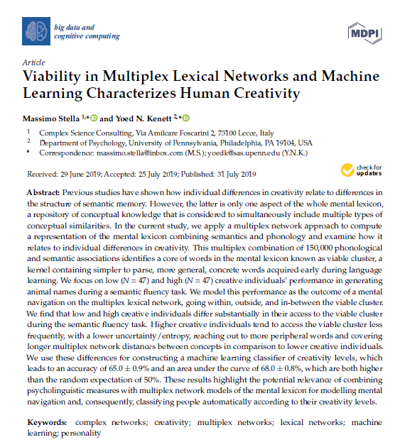
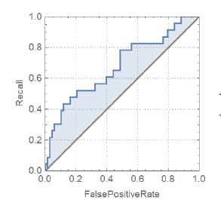
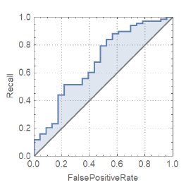
Stella, M., & Kenett, Y. N. (2019)
Notes:
I would also like to say that the current research is largely based on Stella and Kenett 2019, which examined whether creativity can be predicted using cognitive networks.
They found that it is possible to classify low and high creativity using cognitive (multiplex) networks.
That is important to us because, as I’ve mentioned, this research is largely based on previous work of Massimo stella and Yoed Kenett, which showed that creativity scores can be classified using multiplex network.
Their work, and the relation between openness and creativity, gives us a hint that openness can also be predicted using multiplex networks.
predict high-level cognition based on mental navigation over the mental lexicon

Slide 6
General Aim
Predict high-level cognition based on mental navigation

Slide 7

Study 1

Slide 8
Goals
Investigating the role of the mental lexicon in Openness to Experience
Predicting and classifying Openness to Experience scores using a multiplex network’s measures

Slide 9
Participants
Data obtained from Beaty et al., 2018 included 163 participants (113 women, mean age = 22.50 years, SD = 5.79)
Calculating low and high openness groups
Beaty, R. E., Kenett, Y. N., Christensen, A. P., Rosenberg, M. D., Benedek, M., Chen, Q., Fink, A., Qiu, J., Kwapil, T. R., Kane, M. J., & Silvia, P. J. (2018). Robust prediction of individual creative ability from brain functional connectivity. Proceedings of the National Academy of Sciences, 115(5), 1087–1092. https://doi.org/10.1073/PNAS.1713532115

Slide 10
Methods
Openness measure - NEO-PI-3
Semantic Fluency – “Hot” synonyms
Cognitive multiplex network
Notes:
The openness measurement used was Neo-PI-3 standard questionnaire for the big five personality traits, which openness is one of them.
And the semantic fluency task that was used was “hot” synonyms, which meant that participants were required to generate as many synonyms to the word “hot” as possible, in a minute.

Slide 11

Data analysis
Creating the multiplex network
Computing the personalized measures for each subject
Comparing low and high openness individuals’ measures and finding the correlation between openness and each measure
Using machine learning models to classify and predict openness to experience
Testing the Openness trained model on the other Big 5 personality traits
Data split, leave-one-out cross-validation (LOOCV)
Classification – Stepwise logistic regression
Prediction – Stepwise linear regression
Notes:
The data analysis process consisted of:
Creating the multiplex – For that we used WordData repository for three layers - synonyms, hypernyms and phonological, and we used small world of words website in order to create the free associations layer.
Computing the features – there were 19 measurements, for example,
Number of responses
Maximum permanence in the LVC – which is the largest streak of words in the LVC, that each subject generated.
Fraction of responses in the LVC out of all of the responses.
We then computed the differences between high and low openness individuals (we took the highest and lowest 30%, acceptable in the literature), and calculated the Pearson correlation between openness and each measurement, in order to have an idea on what are the best features for the next step,
Which was using Machine learning models.

Slide 12
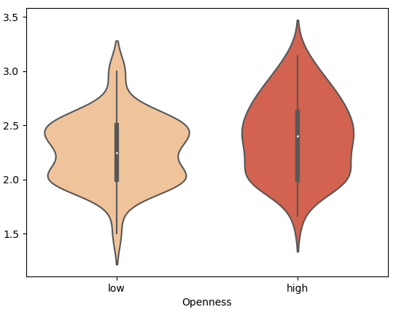
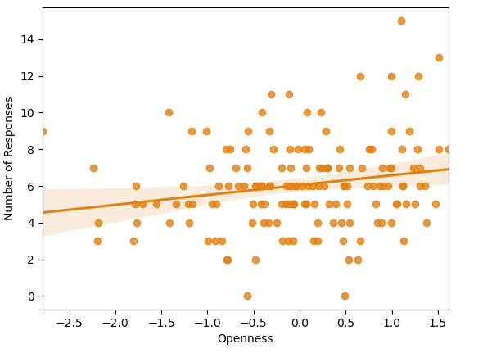
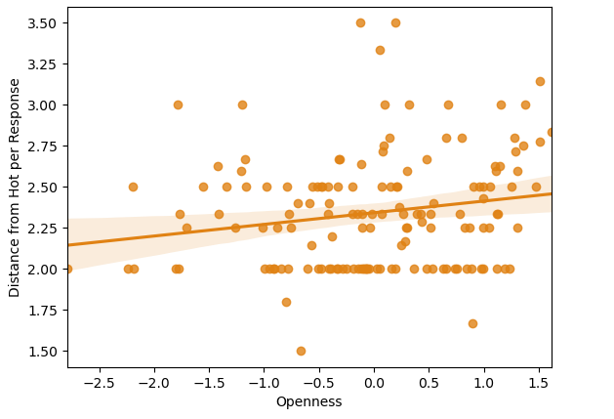
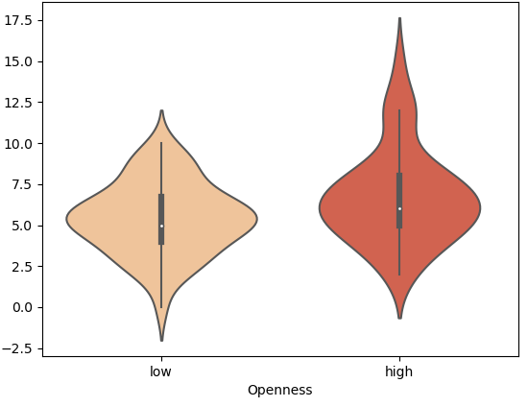
Results – comparison and correlation
Distance from “Hot” per response
Number of responses
r =.18
p =.025
r =.20
p =.013
*
*
Low High
Openness
Low High
Openness
Notes:
When comparing the multiplex measurements between low and high openness subjects, we found 10 significant differences in mann whitney test.
When calculating Pearson r between multiplex measurements and openness we found 7 significant relations.
These are two examples of each.

Slide 13
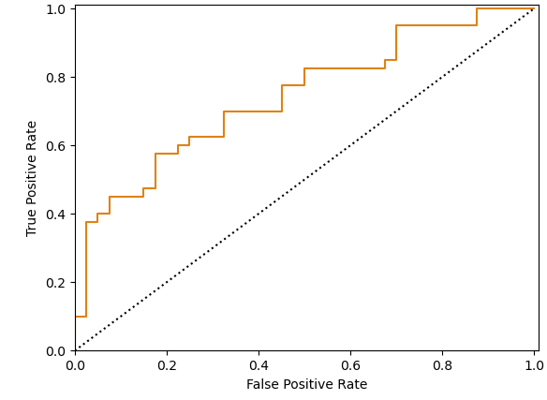
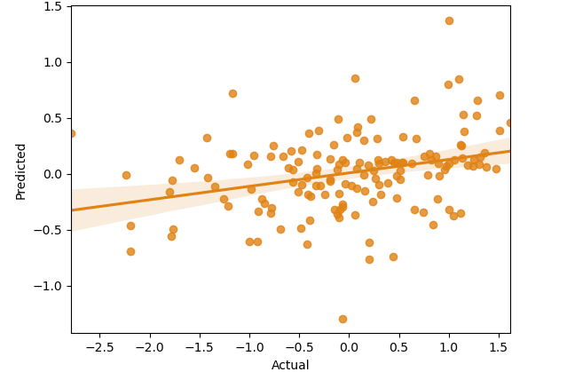
Results – Classification and Prediction
Classification
AUC = 0.75
Prediction
R=0.31, p<.001, MSE=0.74
Notes:
A lot of the important features were related to the Largest viable cluster
Right is Pred
Using loo
Features used were: Fraction of Responses in LVC, Entropy of LVC Accesses, Max Permanence in LVC, Norm1

Slide 14
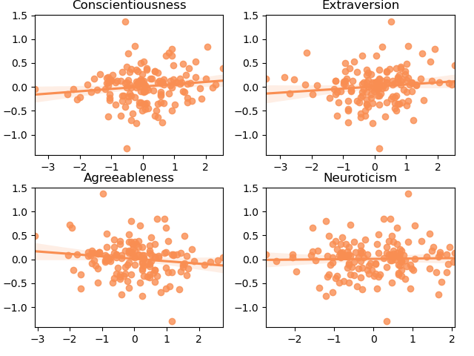
Model Specificity
r = .13
p = .09
r = .12
p = .13
Openness trained
Unsuccessful in predicting other traits
r = -.14
p = .07
r = .02
p = .79

Slide 15
Conclusions and discussion
Study 1 -
Evidence for mental lexicon’s relation to personality
Largest Viable Cluster’s role in openness to experience
Model is specific to Openness
Larger dataset to increase model power
Notes:
Finally,
Therefore, it is indeed possible to some extent, to classify and/or predict openness to experience from multiplex networks measurements.
Our future steps include using similar methods in order to predict creativity scores, with a larger dataset.
We expect the larger dataset to increase our model power, and therefore yield interesting results.

Slide 16

Study 2

Slide 17
Goals
Replicate and extend previous results by Stella and Kenett
Replicate and extend prediction ability from study 1
Predict and classify creativity scores using a multiplex network measures
Notes:
Move towards individual differences

Slide 18
Method
479 participants recruited from Prolific Academic
Creativity Measures – Alternative Uses Task (AUT) and Inventory of Creative Activities and Achievements (ICAA)
Semantic Fluency – “Hot” synonyms and animal category members
Variety of measures, including intelligence, personality
Notes:
Alternative uses task –
ICAA –
Variety of tasks – bla, bla and bla

Slide 19
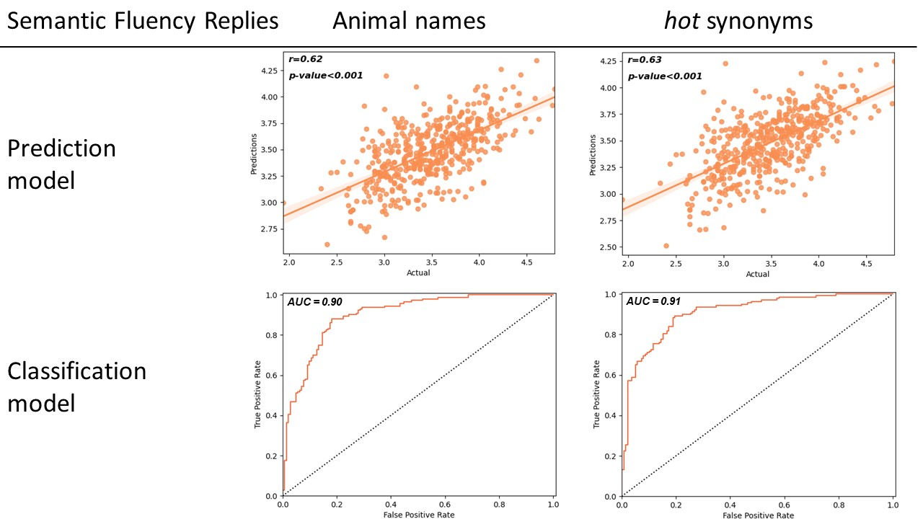
Results – Openness To Experience Prediction
p<.001
MSE=0.11
p<.001
MSE=0.10
Notes:
I’ll dive right into the results of the prediction model this time – When predicting and classifying Openness we found a .62-.63 pearson r between the predicted and the actual results. This time the MSE was smaller 0.11, 0.10.

Slide 20
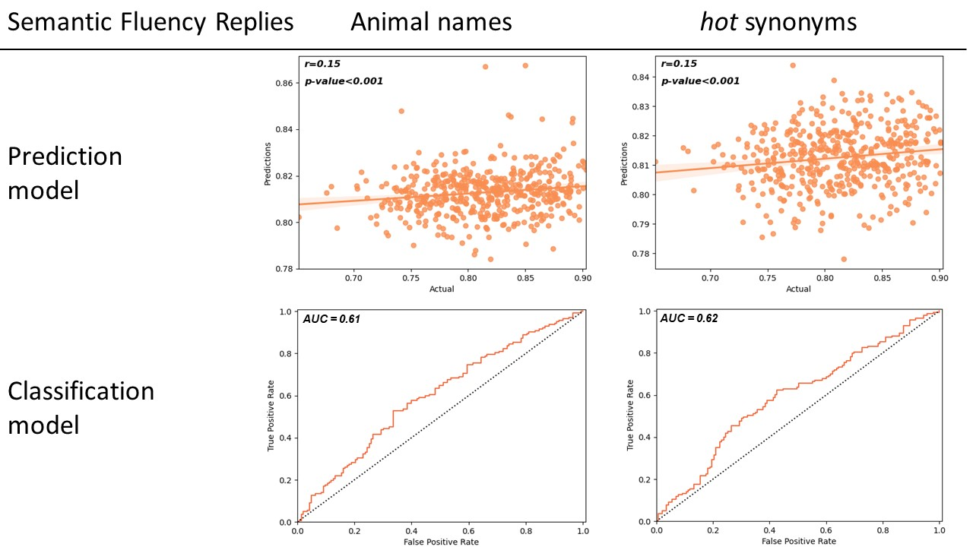
Results – Creativity (AUT) Prediction
p<.001
MSE=0.002
p<.001
MSE=0.002
Notes:
I’ll dive right into the results of the prediction model this time – When predicting and classifying Openness we found a .62-.63 pearson r between the predicted and the actual results. This time the MSE was smaller 0.11, 0.10.

Slide 21
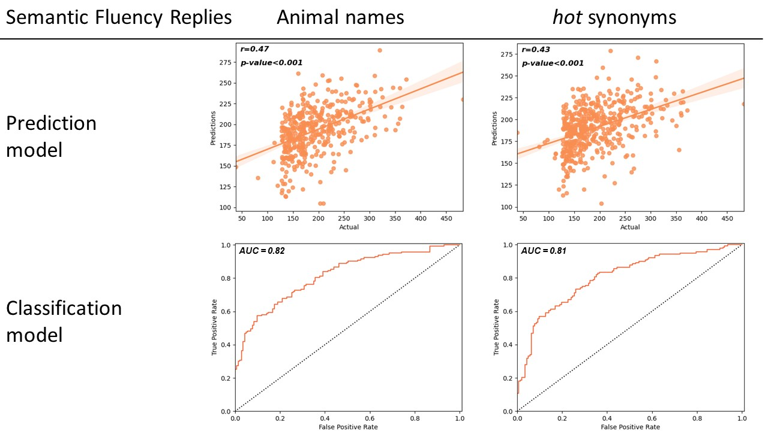
Results – Creativity (ICAA) Prediction
p<.001
MSE = 2454.74
p<.001
MSE = 2616.09
Notes:
I’ll dive right into the results of the prediction model this time – When predicting and classifying Openness we found a .62-.63 pearson r between the predicted and the actual results. This time the MSE was smaller 0.11, 0.10.

Slide 22
Conclusions and discussion
Study 2 -
Improved classification of creativity
Improved prediction and classification of Openness
Larger dataset led to improved results

Slide 23
Limitations
Computing of AUT scores
Better prediction of self report

Slide 24
General Discussion
Simple task to predict complex behavior with high accuracy
Complex cognition studied with networks
Relation between mental lexicon & complex cognition

Slide 25



Thanks
Yoed Kenett
Roger Beaty
Massimo Stella
Notes:
Yoed, Massimo, Roger
For their support and contribution to this project.

Slide 26

Notes:
Thank you all for listening.
Any questions?
Classification – Random forest yielded the best scores
Prediction – linear regression yielded (6 features)
Both with leave one out cross validation.
It doesn’t mean that 31% of the scores were accurately predicted, but that the order and ascend of scores were similar between predicted and actual.

Slide 27
